Slide 1
OCBC Customer Service Report
For the Year of 2021 & 2022
By: Javen Lai

Slide 2
Content
Overall Satisfaction of Services
Inquiries from customers
Performance of branches
Demand of Services

Slide 3
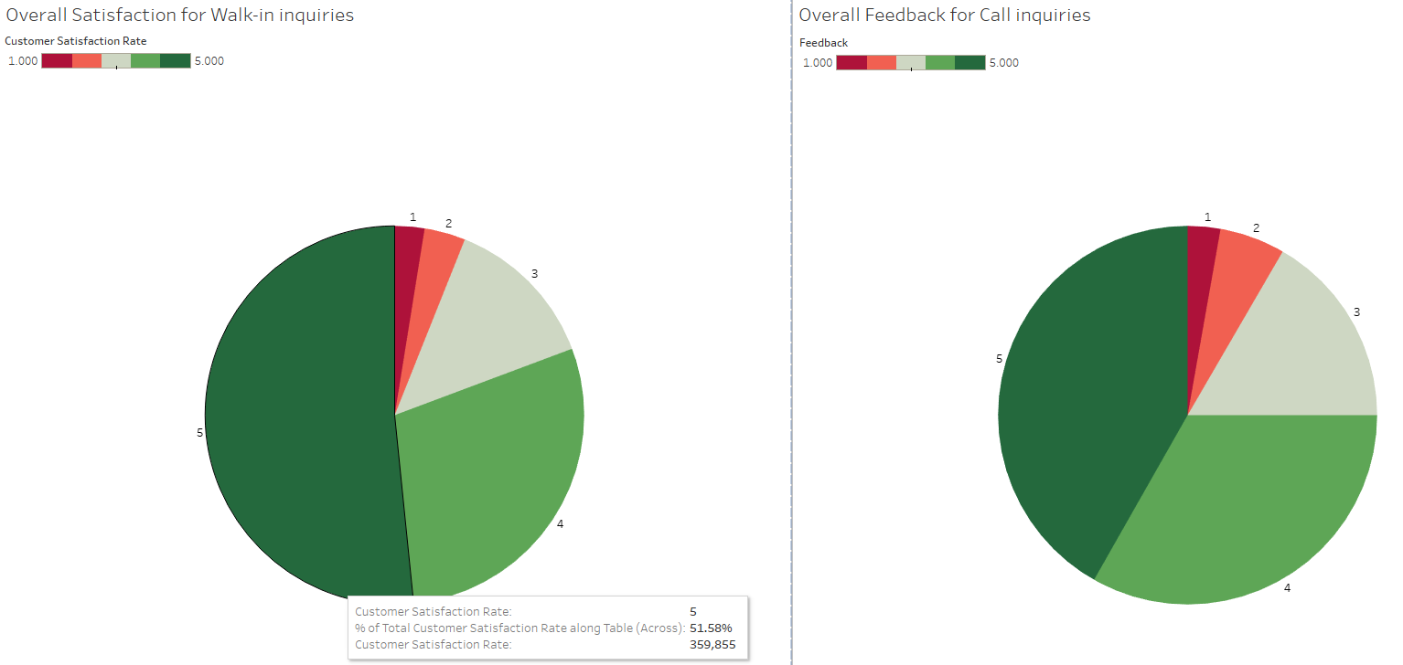
Overall Satisfaction of Services
Insights:
1. Most customers are satisfied
2. Excellent performance by walk-in Agents
3. Slight performance gap for call Agents

Slide 4
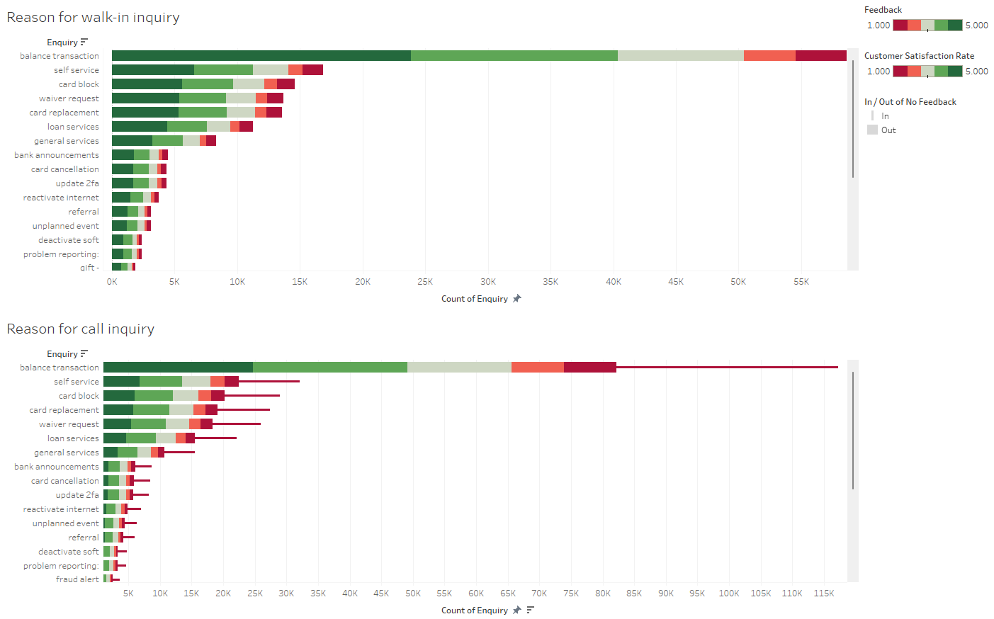
Inquiries from customers
Insights:
1. Most inquiries are related to balance transaction
2. Self service apps may have user experience issues
3. Agents are adept in answering all inquiries

Slide 5
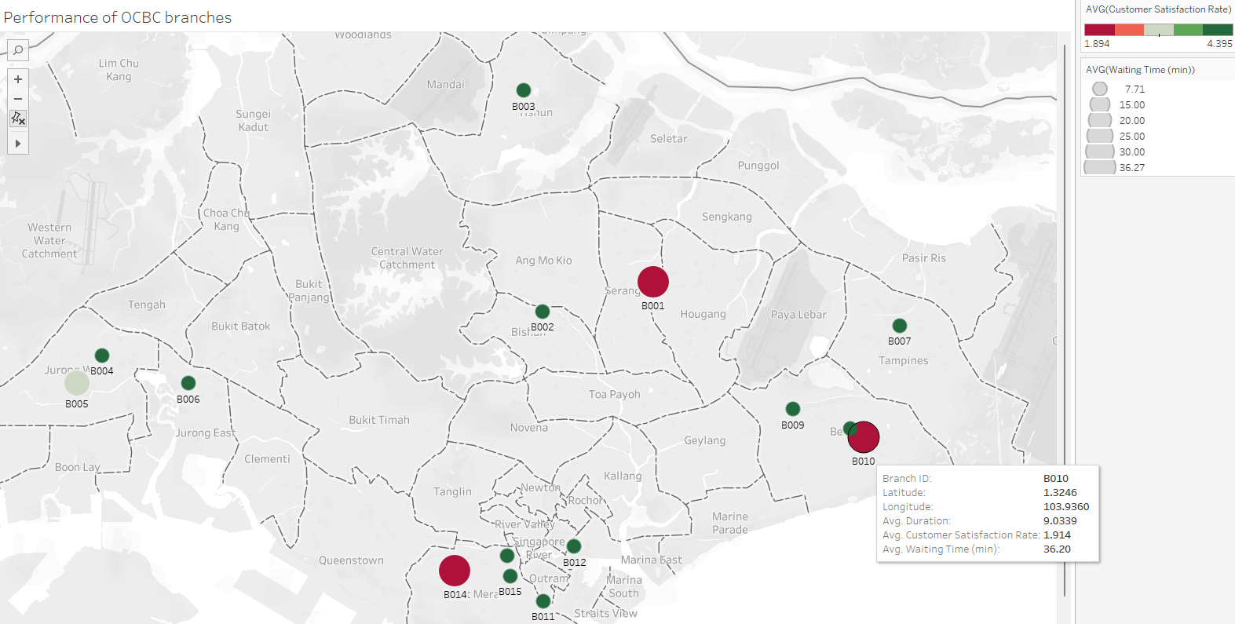
Performance of OCBC Branches
Insights:
Customers hate long waiting time
Rating Impact: Long Waits = Low Ratings
Target Wait Time: <15 Mins for Satisfactory Rating

Slide 6
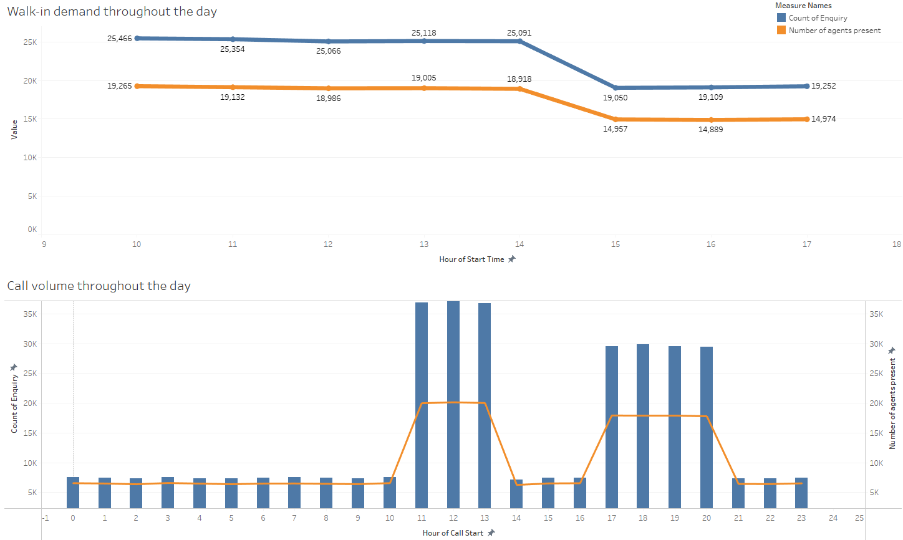
Demand of Services across the day
Peak Hours:
11AM – 1PM,
5PM – 8PM
Insight:
- Call Agent shortage during peak hours

Slide 7
Takeaways
Call-in customer service’s performance is slightly poorer likely due to agents being unable to keep up with demand during peak hours due to understaffing.
User experience for OCBC self-service app may require a revamp.
Customer service agents are well-trained to handle all types of inquiries.
Waiting time should not exceed 15 minutes as customers hate long waiting time.

Slide 8
The End
Do you have any questions?

